Slide 1
FINAL AI PROJECT
Project Report & Presentation
AI Research • Chatbot • Computer Vision • Voice Assistant • Automation
Eco Sage • Garbage Image Classification
1

Slide 2
1. Project Portfolio
Level 1: AI Applications Research, Basic Rule-Based Chatbot, AI Presentation
Level 2: Face Detection, Basic Voice Assistant, AI Automation
Level 3: Eco Sage Environmental & Biodiversity AI, Garbage Image Classification
Portfolio focus: practical AI applications with user-facing outputs
2

Slide 3
2. Objectives
Understand real-world Artificial Intelligence applications
Build interactive AI applications instead of only studying theory
Explore conversational AI, computer vision, speech, automation and deep learning
Develop environmental intelligence for biodiversity and environmental metrics
Document implementation, testing, limitations and future scope
3

Slide 4
3. Level 1 – AI Applications Research
Healthcare: medical image analysis, decision support, monitoring and drug discovery
Education: personalized learning, intelligent tutoring and automated assessment
Business: recommendations, forecasting, fraud detection and workflow automation
Daily life: voice assistants, search, navigation, translation and smart devices
Output: formal research paper + presentation
4

Slide 5
4. Level 1 – Basic Rule-Based Chatbot
Streamlit-based conversational interface
User input → keyword/pattern matching → predefined response
Includes fallback behavior for unsupported inputs
Demonstrates deterministic conversational AI
Provides the foundation for later AI-agent and language-model systems
5

Slide 6
5. Level 2 – Face Detection
Computer vision project using OpenCV
Haar Cascade classifier used to locate faces
Workflow: image/frame → preprocessing → detection → bounding boxes → display
Focus is face detection, not identity recognition
Useful for learning real-time visual perception
6

Slide 7
6. Level 2 – Voice Assistant
Hands-free interaction through speech
Microphone input → speech-to-text → command interpretation → response/action
Demonstrates speech processing and simple natural-language command handling
Can be extended with more commands, multilingual support and error recovery
7

Slide 8
7. Level 2 – AI Automation
Python-based workflow automation
Collect input/data and apply programmed or AI-assisted logic
Execute repetitive actions automatically
Focus: reducing manual effort and improving workflow consistency
8

Slide 9
8. Level 3 – Eco Sage
Environmental and biodiversity AI assistant
Inputs: soil, climate, land use, biodiversity, human impact, location and time
Conversational questions + structured environmental data
AI reasoning produces analysis, explanations and actionable recommendations
Interactive features include chat, reports, dashboards and structured export
9

Slide 10
9. Eco Sage – Processing Workflow
User Input
Text + structured data
Validation
Check context / missing data
Environmental Agent
Reason over inputs
Output
Report / chat / recommendation
→
→
→
10

Slide 11
10. Level 3 – Garbage Image Classification
Deep-learning computer vision project for waste categorization
Dataset → image preprocessing → model training/fine-tuning → evaluation → prediction
Interactive application can return predicted class and confidence information
Recycling-oriented feedback connects classification with practical waste management
Transfer learning such as MobileNetV2 is suitable for lightweight deployment
11

Slide 12
11. Technology Stack
Python – core programming language
Streamlit – interactive application interfaces
OpenCV – computer vision and face detection
Machine Learning / Deep Learning – image classification
Gemini-based AI reasoning – environmental assistant
CSV / JSON / image datasets – structured and visual data
VS Code + Git – development and project organization
12

Slide 13
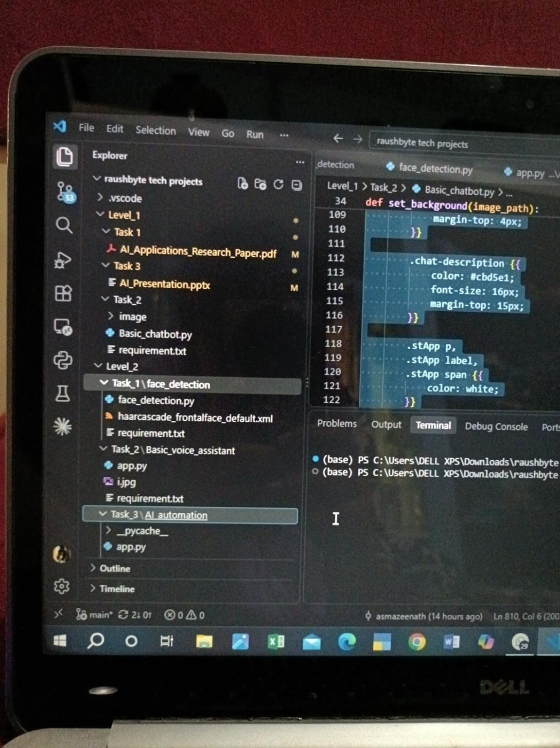
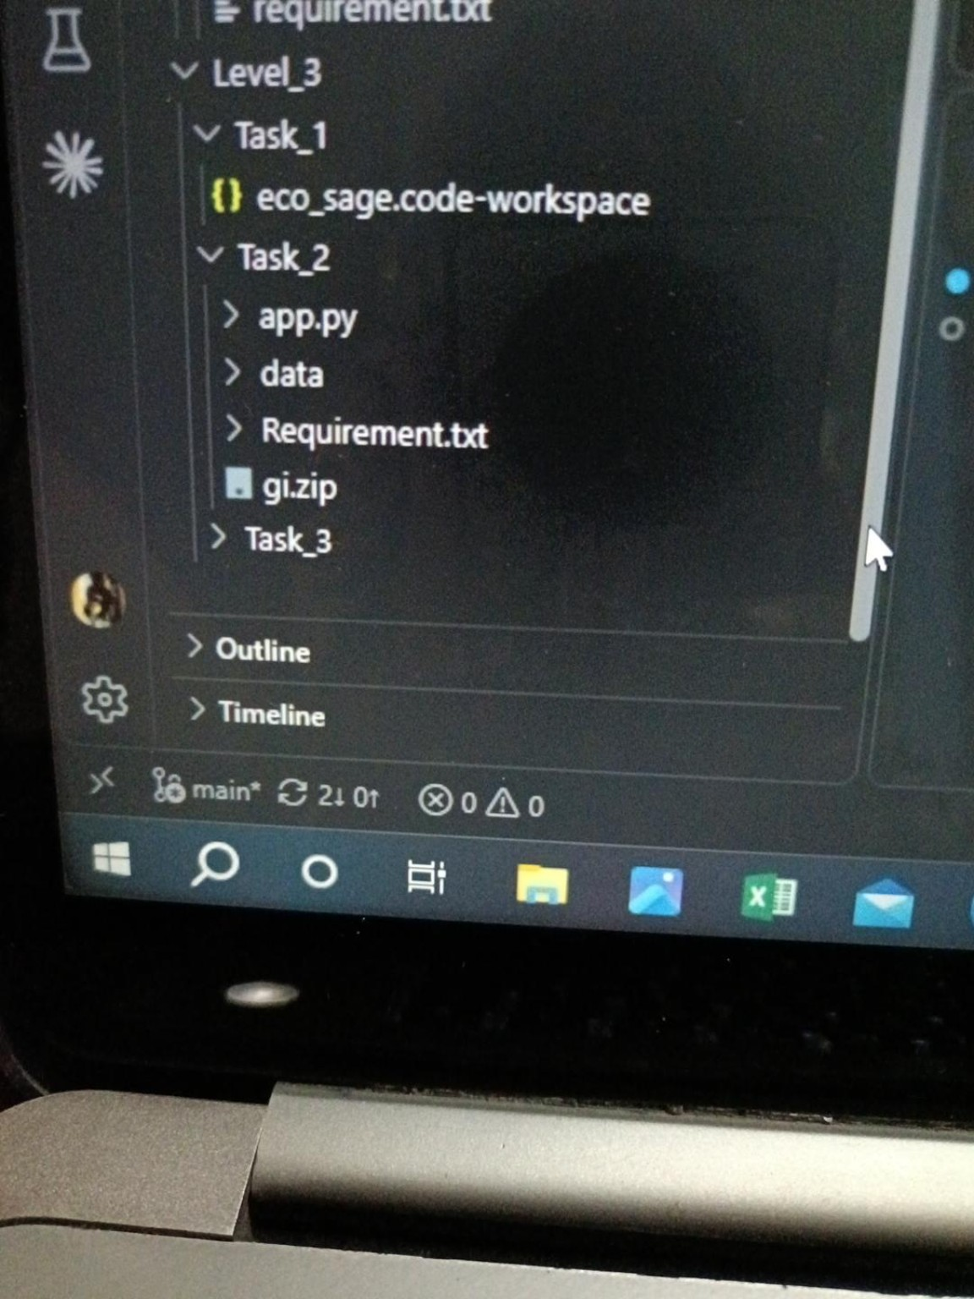
12. Project Workspace Evidence
13

Slide 14
13. Testing & Evaluation
Chatbot: verify known inputs, unknown inputs and response consistency
Face detection: test different images, faces, scales and lighting
Voice assistant: test supported commands, transcription and noise conditions
Automation: verify workflow completion and repeatability
Eco Sage: test complete/incomplete context and relevance of recommendations
Garbage classification: evaluate accuracy, precision/recall and confusion matrix
Gitup link: https://github.com/asmazeenath/raushbyte-tech-projects.git
14

Slide 15
14. Key Outcomes
Covered multiple AI modalities in one portfolio
Moved from deterministic rules to ML/deep learning and AI reasoning
Built user-facing applications rather than only isolated models
Applied AI to environmental intelligence and waste classification
Developed practical understanding of data, models, interfaces and deployment considerations
15

Slide 16
15. Limitations
Rule-based chatbot: limited to predefined patterns
Haar Cascade: sensitive to pose, lighting and image quality
Voice assistant: affected by noise, accents and speech-recognition errors
Image classification: depends on dataset quality, class balance and diversity
Eco Sage: recommendations require validation with reliable environmental measurements and domain expertise
16

Slide 17
16. Future Scope
Modern vision detectors and stronger model evaluation
Multilingual voice assistant and richer automation integrations
Eco Sage: live weather, satellite/LULC data, biodiversity databases, maps and trend analysis
Larger and more diverse garbage datasets with improved validation
Automated testing, model versioning, monitoring and CI/CD
17

Slide 18
17. Conclusion
The portfolio demonstrates a complete progression from AI fundamentals to applied intelligent systems.
It combines conversational AI, computer vision, speech, automation, environmental AI and deep learning.
Eco Sage adds environmental and biodiversity reasoning, while garbage classification demonstrates visual AI for waste management.
The projects provide a strong foundation for further work in AIML, computer vision, conversational AI and intelligent automation.
18

Slide 19
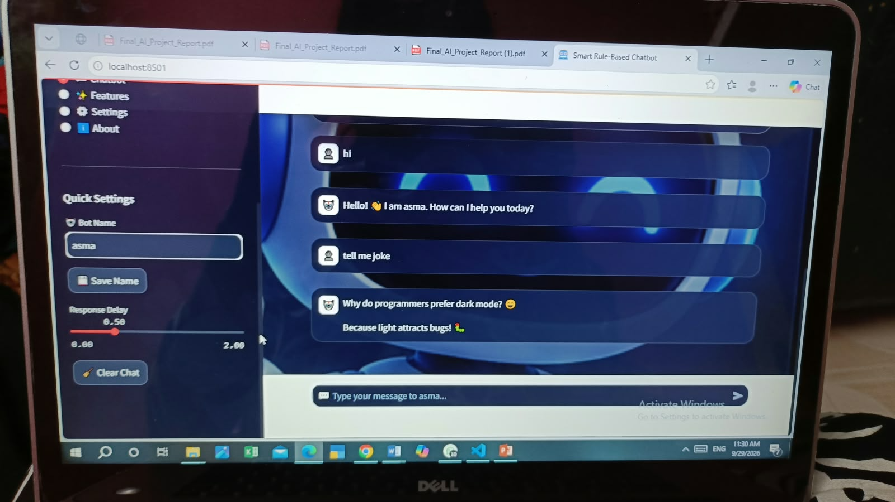
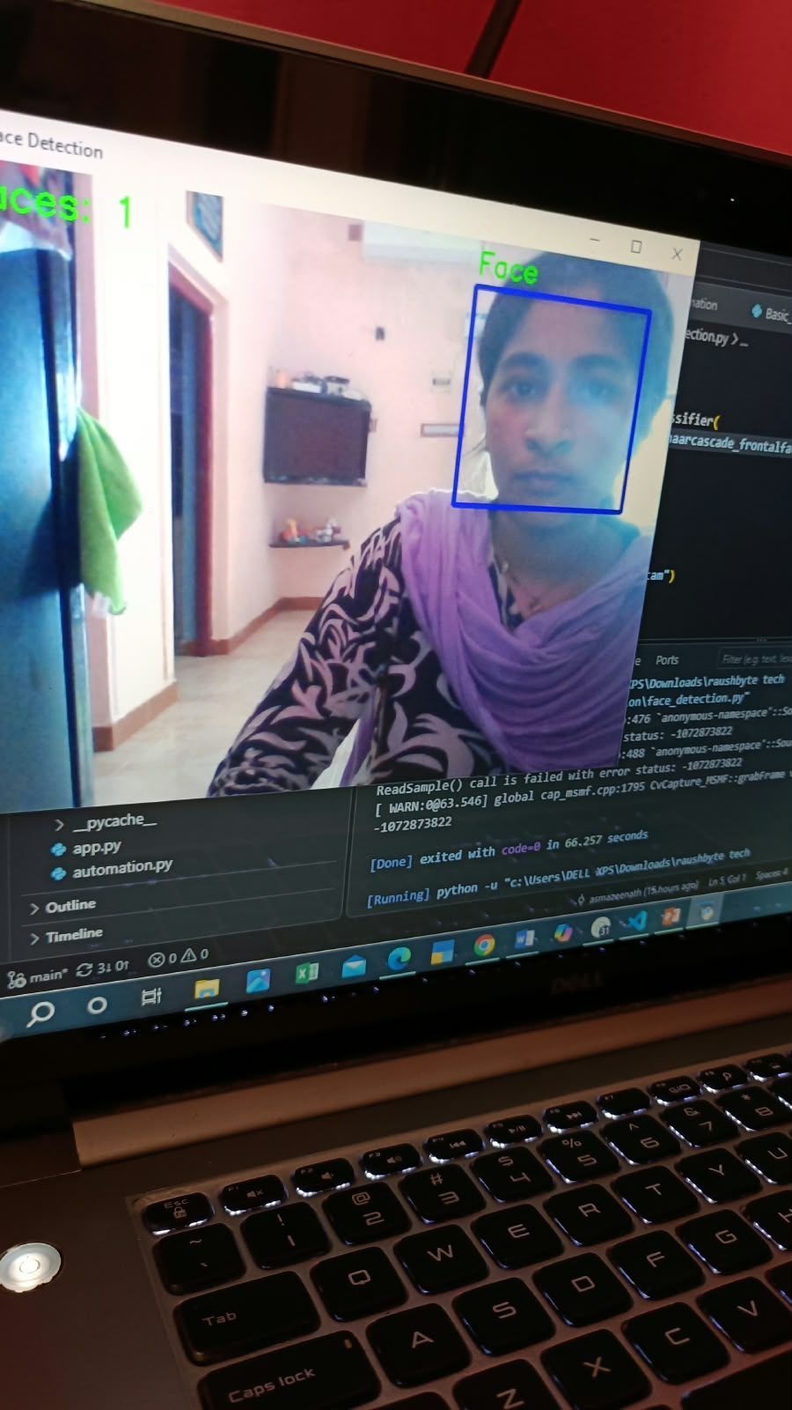
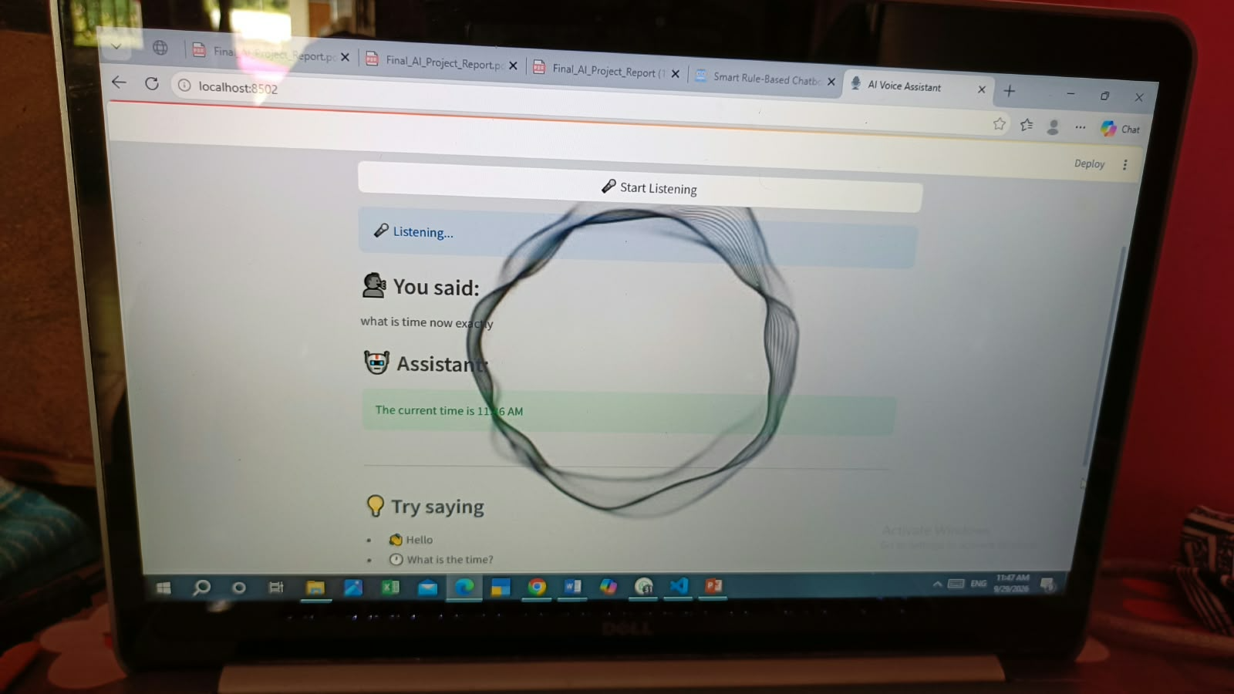
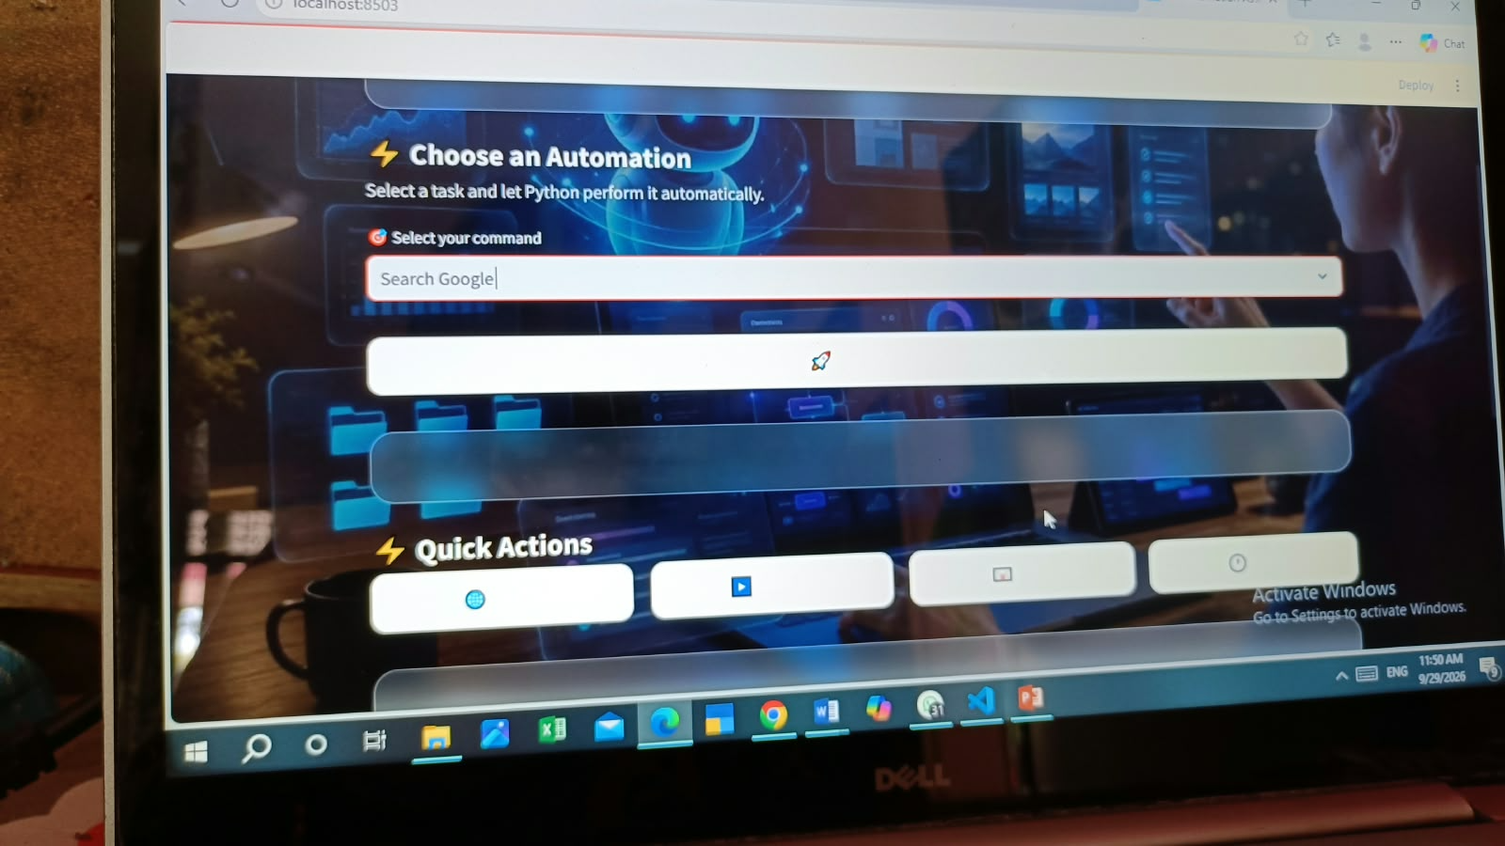
17. OUTPUT
.
18

Slide 20
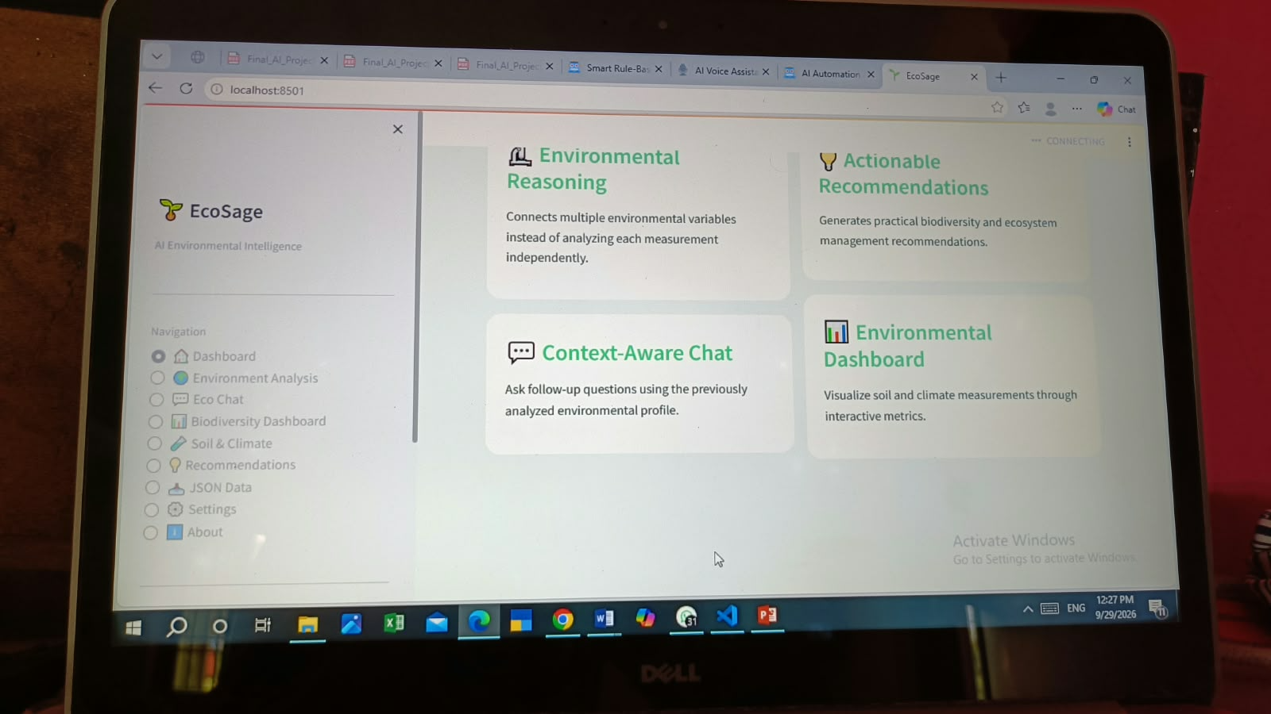
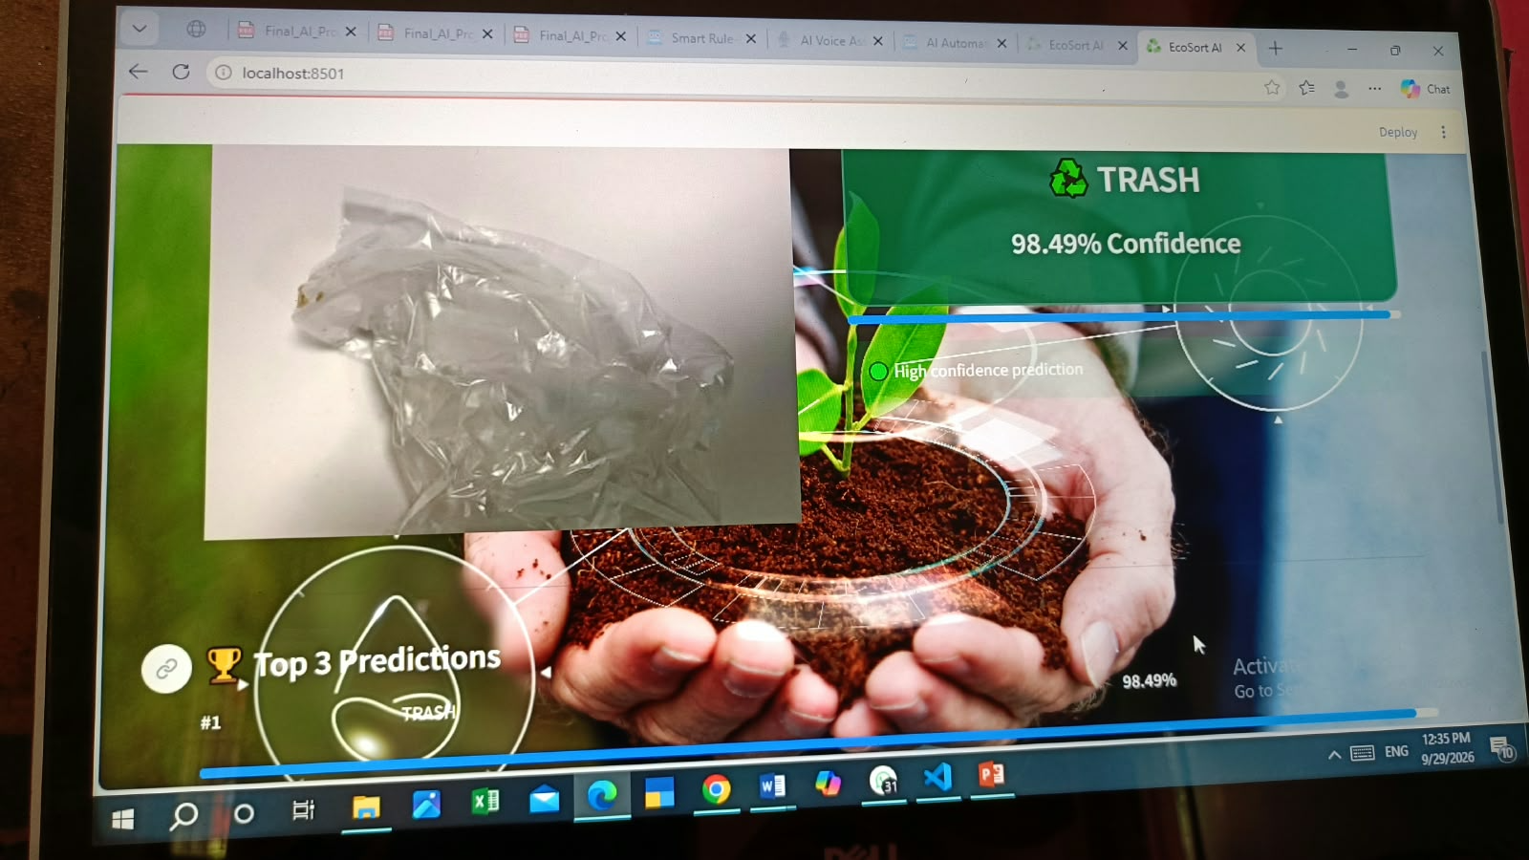

Slide 21
THANK YOU
Questions & Discussion
AI Project Portfolio – Level 1 to Level 3
19

